Slide 1
Account Receivables Part 2
Notes:
This In-house course was developed to meet the needs of SAP R/3 Consultants working at Capgemini. This course is designed to present a high level view of XXXX and to provide the Consultants with basic information about how to use this Functionality.
More in-depth courses have been developed to train Consultants in specific areas discussed during this course.
Your comments at the conclusion of this training session are appreciated and will help us better tailor future courses to meet your training needs.

Slide 2
Content
Clearing open items
Adjustment of payment differences
Special GL transactions

Slide 3
Incoming Payments
Manual Incoming Payments
Incoming Payments
Reconcile With Customer Open items
1
Automatic Incoming Payments
2
Electronic Incoming Payments
3

Slide 4
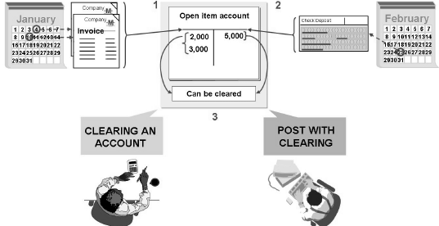
Clearing open items
Open items are incomplete transactions, such as invoices that have not been paid.
Documents cannot be archived until they are cleared.
Types of clearing in SAP Financials:
Post with clearing
Account clearing
A clearing transaction always creates a clearing document.

Slide 5
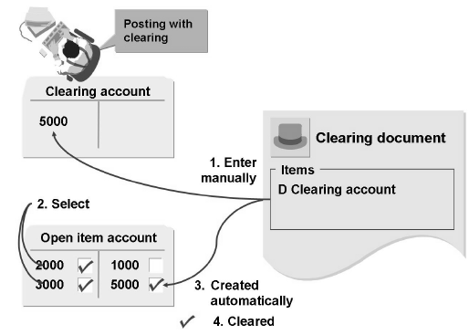
Post with clearing
When you use the "posting with clearing" function, enter the clearing document amount and then select the open items that are to be cleared.
If clearing amount equals selected open items amount system clears it.
If there is any difference system allows to post the difference.
Post with clearing can be done either manually or by Automatic Payment Program.

Slide 6
Clear Customer Transactions.
Clear outstanding items on Customer’s – F-32
Post Customer’s documents with clearing – F-30
Reverse documents – FB08 & F.80.
Perform automatically clearing procedures
Reversal of Clearing.

Slide 7
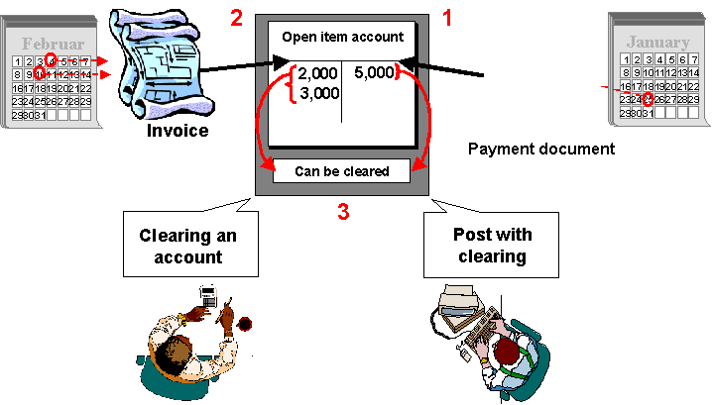

Open Item Clearing
1
2
3
Notes:
Open items are incomplete transactions, such as an invoice for which goods or services have not yet been received.
In order for an open item transaction to be considered complete, the transaction must be cleared. A transaction is considered cleared when an offset value is posted to it, so that the resulting balance of the items is zero.
In the above example:
Two invoices are posted to the Customer account. These invoices are regarded as the open items because at this point the corresponding payment has not been received.
The payment is received and the invoices are set off against it.
The transaction is now cleared and the resulting balance is zero.

Slide 8
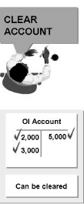
Automatic clearing program
Steps in the clearing program
Group items for each account
If balance is zero, items are marked for clearing.
Prerequisites for clearing
User criteria must be defined in customizing
Accounts to be cleared must be defined for automatic clearing
Items that are not cleared:
Noted Items
Statistical postings, bill of exchange postings
Items with withholding tax entries.

Slide 9
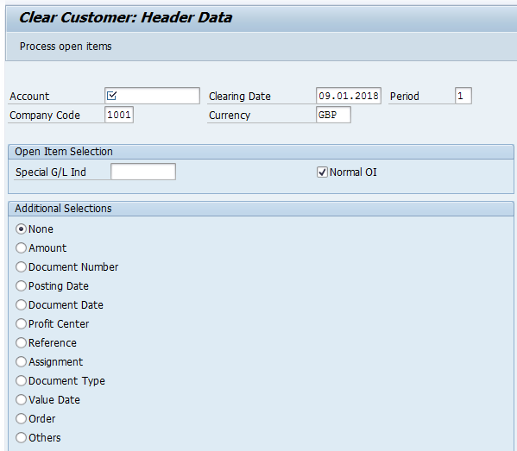
Clear Customer Transaction code F-32

Slide 10
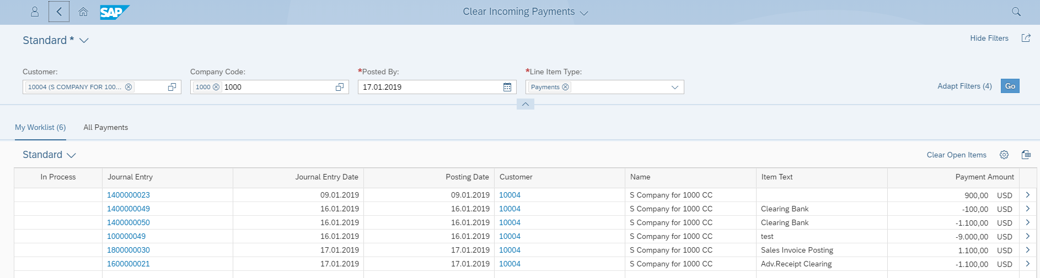
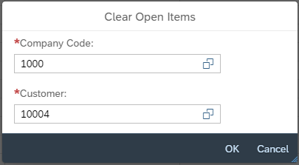
Clear Incoming Payments
1. Enter Customer ID
2. Enter Company Code
3.Select “Go” Button
4.Enter Company Code & Customer ID
5.Select “Ok” Button

Slide 11
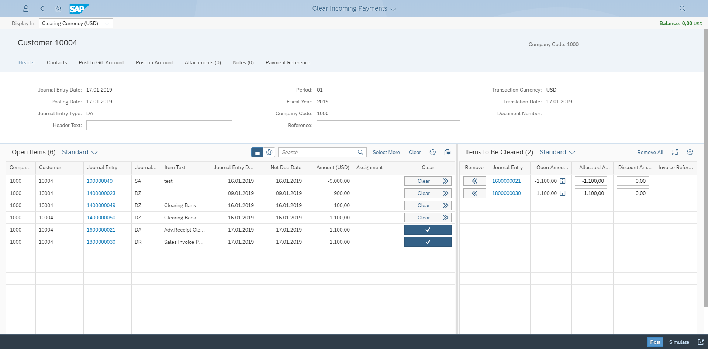
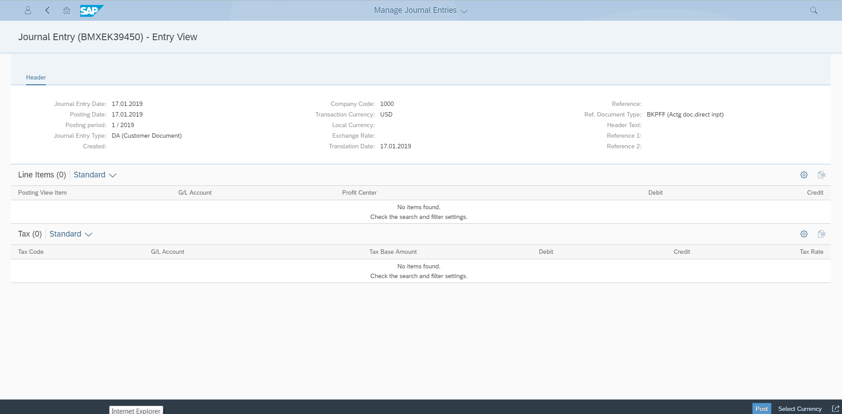

Clear Incoming Payments
6.Select Clear Item Document
7.Click Post Button
8.Sucessfully Document Posted

Slide 12
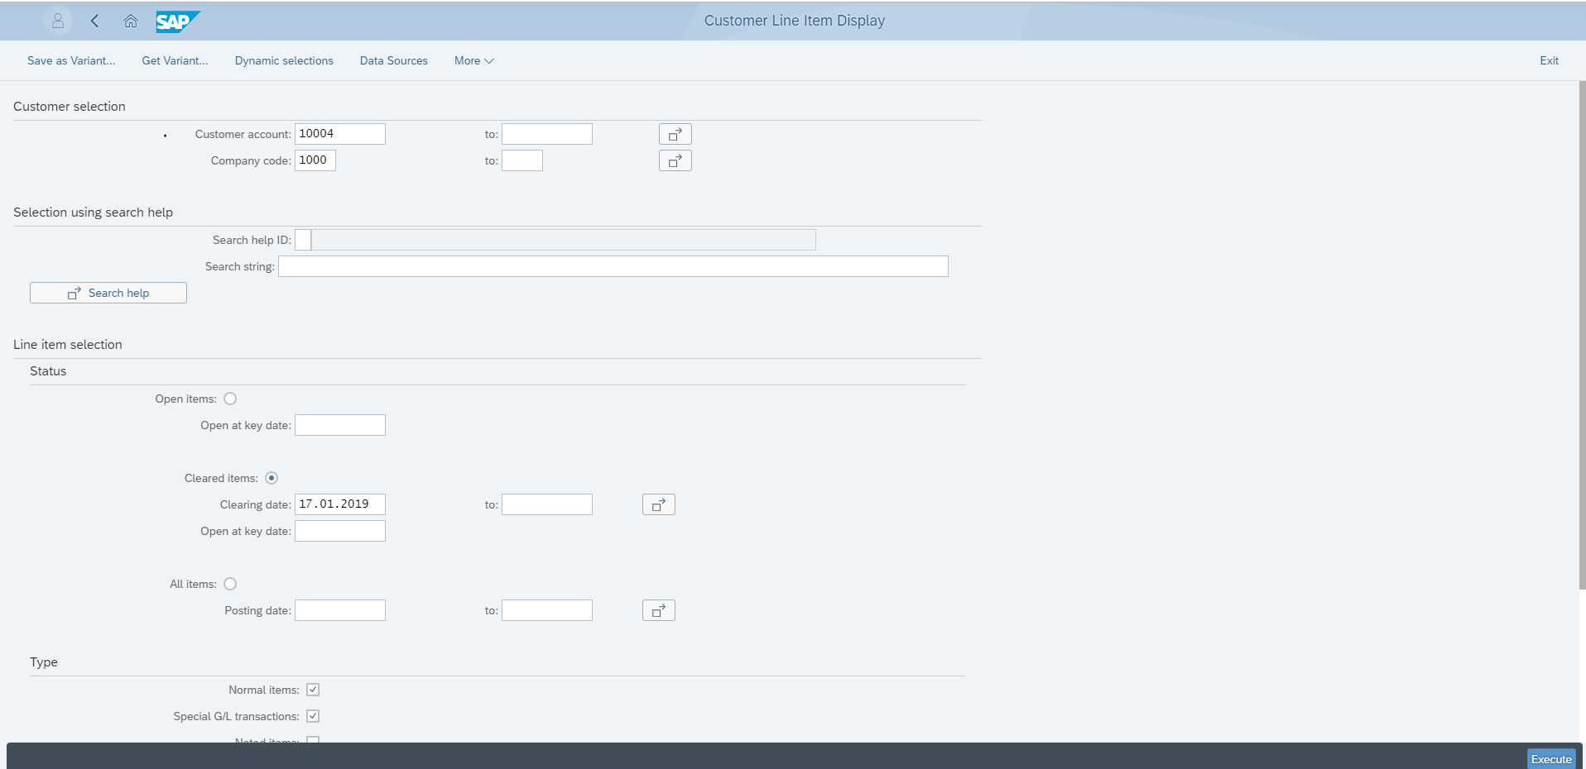
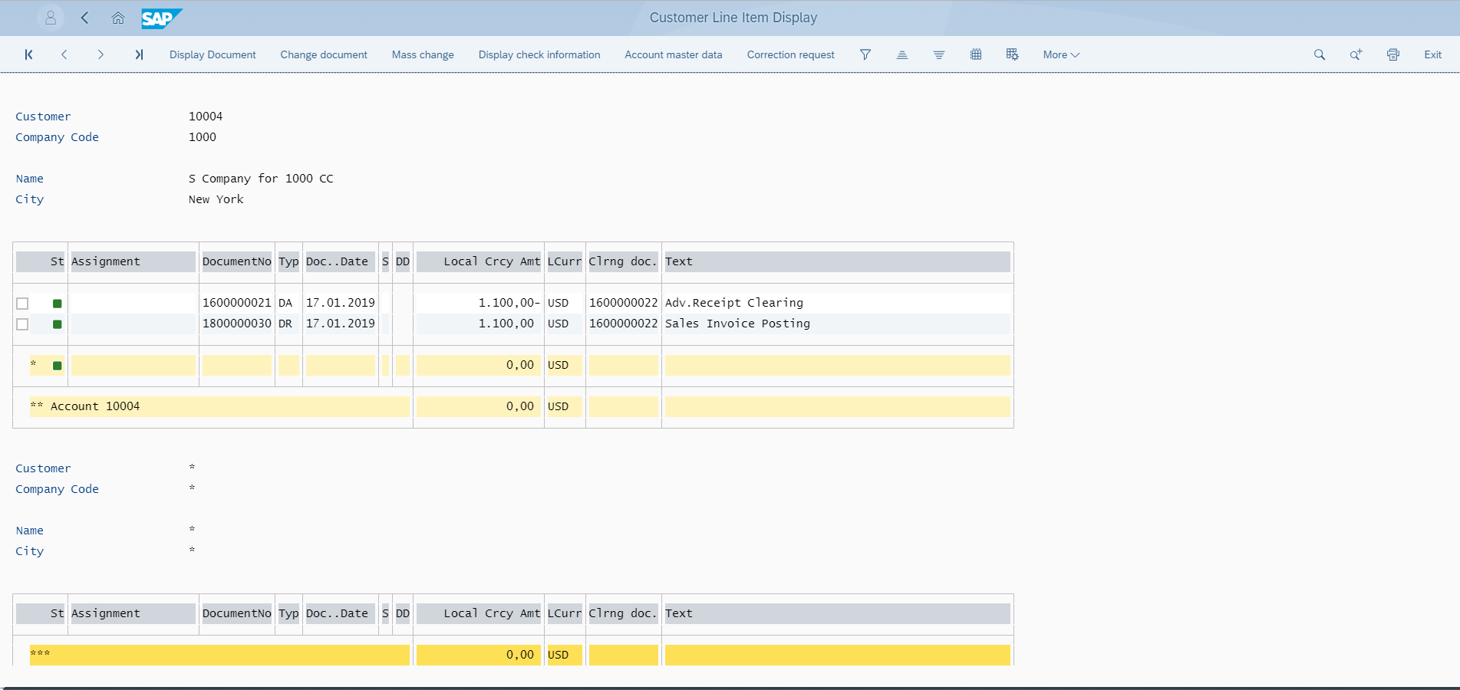
Clear Incoming Payments
9.Select Clear Item Document
10.Select Clearing Date
11.Click “Execute” Button
12. Cleared Line Item Document Displayed

Slide 13
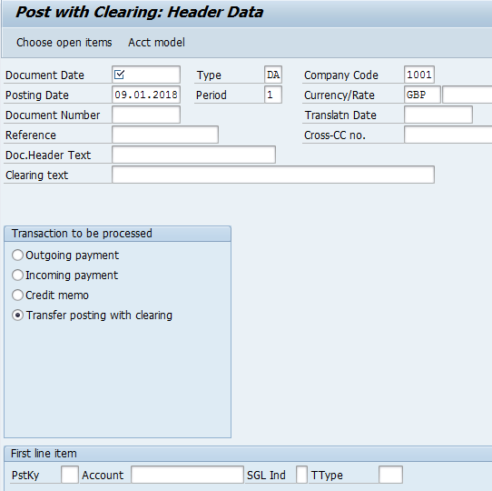
Post Customer’s documents with clearing – F-30

Slide 14
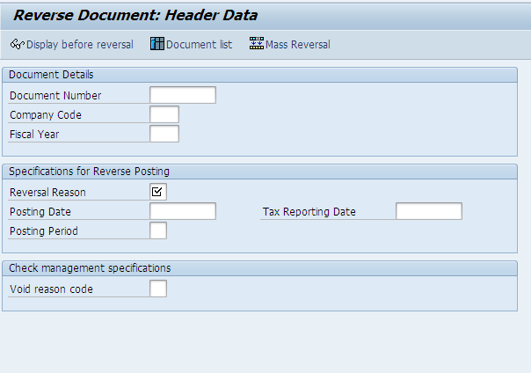
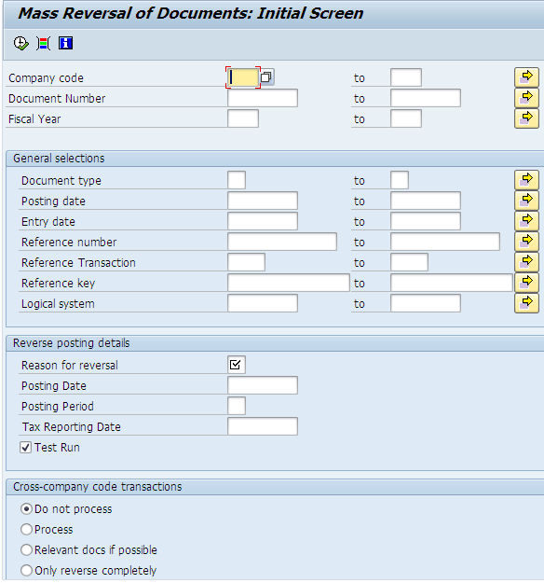
Reverse documents – FB08 & F.80.

Slide 15
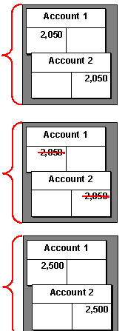
Reverse a Customer document
Document entered incorrectly
Balance sheet
Assets
Liabilities
Document corrected by Reversal:
Reverse with a standard reversal posting
Reverse with a negative posting
Shared equity
Document re-entered correctly
Notes:
“Nobody’s perfect”. As a result, the document created may contain incorrect information.
The system provides a function to reverse G/L, A/R and A/P documents both individually or in mass process.
A document may be reversed either by:
entering a standard reversal posting or
entering a negative posting.
To reverse a document user must enter the reason code.
Documents with cleared items cannot be reversed. The clearing document must first be reset.
To enable negative postings, you need to set the relevant indicators: for the company code and a relevant document type.

Slide 16
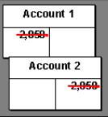
Mass Reversal of Documents
Mass Reversal Procedure
Many documents may be reversed at the same time,
Process may be scheduled to be performed in the background.

Slide 17
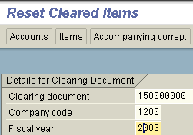
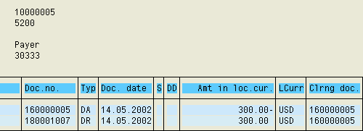
Reversal of Clearing
Display cleared items
Reversal of clearing
Reversal of documents that were cleared before is not possible,
First the clearing operation must be reset.

Slide 18
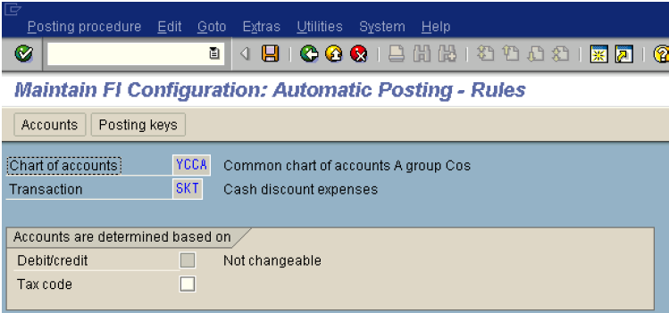
Perform automatically clearing procedures
Notes:
Select the Accounts button on top and mention the Discount (Expenes) GL. System will capture the discount amount automatically, whenever the discount granted to the customers while clearing the open items.

Slide 19
Clearing – Partial & Residual.
If the payment difference is the outside the Tolerance limit, it has to be processed manually Post the payment as a partial payment, where all the documents remain in the account as open items
Post the payment difference as a residual item, whereby only the residual item remains in the account and the original document and the payment are cleared. A new document number is created with reference to the original documents.
Post the payment difference to a different account as a difference posting
using reason codes and automatic determination.
. Write off the difference (manual account assignment)
Partial Clearing.
Residual clearing.

Slide 20
Clearing – Partial & Residual.

Slide 21
Resetting Cleared Items.
Users can reset clearing for individual documents. When you reset clearing, the clearing data is removed from the items.
The changes are logged and can be displayed in change documents.

Slide 22
Payment differences
Objective
After the lesson you will be able to:
Post payment differences
Describe tolerance groups and their role for posting payment differences
Post partial and residual payments
Create and use payment difference reason codes

Slide 23
Tolerance groups
Customers often pay invoices with deductions that sometimes exceed the tolerance limits of the company.
In accounting there are three types of tolerances:
Employee tolerance group: (refer authorizations lesson slides)
Upper limits for posting transactions
Permitted payment differences
G/L account tolerance group:
Permitted payment differences (ex: automatic clearing procedures).
Customer/vendor tolerance groups:
Permitted payment differences
Clearing transactions
Posting residual items from payment differences
Tolerances for payment advice notes

Slide 24
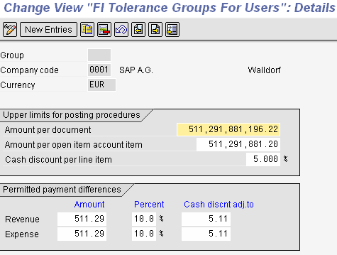

Slide 25
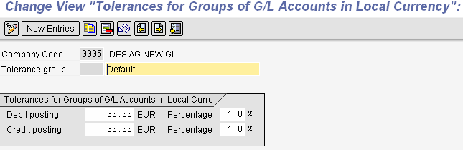

Slide 26
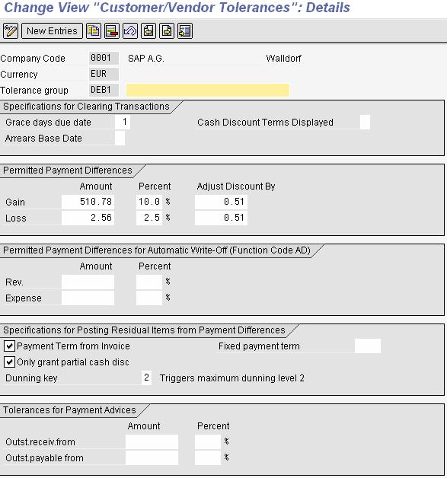

Slide 27
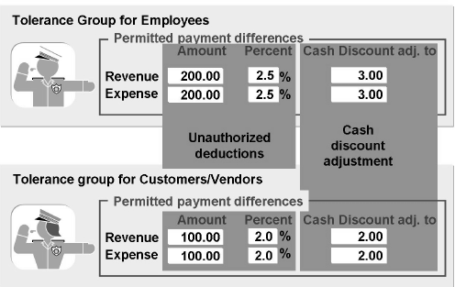
Permitted payment differences
Consider an example of Customer invoice. At the time of clearing the least of employee tolerance and customer tolerance group is considered by the system.
They control the automatic posting of cash discount adjustments and unauthorized customer deductions.

Slide 28
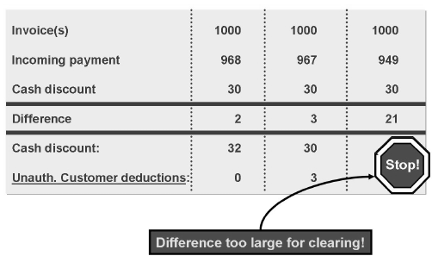
Example on payment difference
Considering the below example:
If the difference in payment is within the tolerance of cash discount it is adjusted to cash discount account.
If difference exceeds cash discount adjustment and within unauthorized tolerance limit then adjusted to unauthorized customer deductions.
If difference exceeds unauthorized tolerance limit then it has to be processed manually.

Slide 29
Processing payment differences
Processing
payment differences
Within defined
tolerances
Outside of
tolerances
Automatic
cash discount
adjustment
Manual
cash discount
adjustment
Partial
payment
Residual
items
Automatic
Posting of
unauthorized
deductions
Clear
Difference
manually
Payment on
account

Slide 30
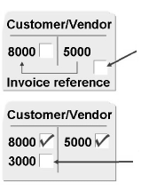
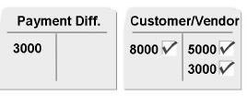
Manually processing – Outside tolerance limits
Partial payment
Both items remain as open items
Residual items
Payment amount and invoice are cleared and new item gets generated with remaining amount.
TOP (from cleared item/new TOP)
Payment differences
Post the payment difference to a different account as a difference posting using reason codes and automatic determination.
Partial payment
Residual item
Payment differences

Slide 31
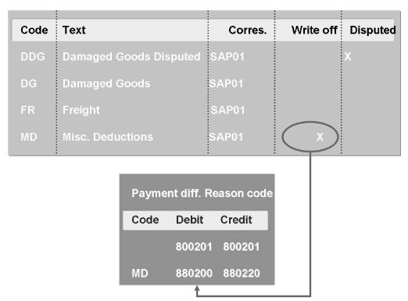
Reason codes
Reason codes are used to describe the reason for the payment difference.
To assign more than one reason code to a payment difference, click on “distribute difference”.
Reason codes can be assigned to:
Difference postings
Partial payments
Residual items

Slide 32
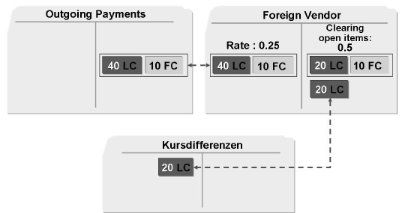
Realized exchange rate differences
When clearing open items in a foreign currency, exchange rate differences may occur due to fluctuations in exchange rates.
The system posts these exchange rate differences automatically as realized gains or losses.
The system posts the differences automatically to the revenue/expense account for exchange rate differences that you defined during configuration.
The realized difference is stored in the cleared line item.

Slide 33
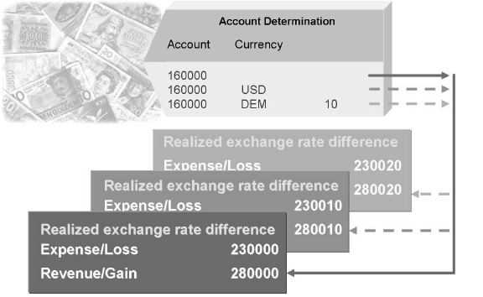
Account determination
All reconciliation accounts and all G/L accounts with open item transactions in foreign currency must be assigned revenue/expense accounts for realized losses and gains.
One gain/loss account can be assigned:
To all currencies and currency types
Per currencies and currency type
Per currency
Per currency type

Slide 34
Unrealized exchange rate differences
Exchange rate differences are also posted when open items are valuated for the financial statements.
These exchange rate differences from valuation are posted to another exchange rate difference account (unrealized loss/gain) and to a financial statement adjustment account.
When clearing an open item that has already been valuated, the system reverses the balance sheet correction account and posts the remaining exchange rate difference to the account for realized exchange rate differences.

Slide 35
Special G/L transactions
Unit Objectives
Describe special G/L transactions
Explain the particularities of special G/L transactions
Explain the functions of special G/L transactions
Configure special G/L transactions or check their configuration
Create your own special G/L transactions as needed

Slide 36
Special GL transaction
Reconciliation account:
Transactions in the sub ledgers (AR/AP) are also posted on the reconciliation accounts in the general ledger, to have the values available in form of totals as well in the general ledger in order to be able to quickly create a financial/income statement.
The Reconciliation Account field can be found in the company code segment of the customer/vendor master record.
For example when you post a vendor, automatically the reconciliation account also gets posted.
But
Certain business transactions should be displayed separately in the general ledger and sub ledger in financial accounting.
Ex: Down payment to vendor is not a liability hence to be shown on assets side. Down payment request, Doubtful receivables etc.
For this type of transactions ALTERNATIVE RECONCILIATION ACCOUNTS are used.

Slide 37
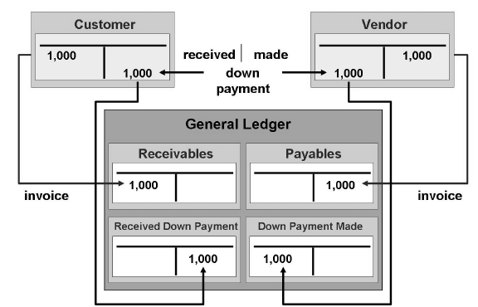
Alternative Reconciliation account
Special G/L transactions are transactions in the accounts receivable and payable, which are displayed separately in the general ledger and the sub ledgers.
When you post vendor account, respective RECONCILIATION ACCOUNT is posted.
When you post vendor account (using a SPL G/L INDICATOR), respective
ALTERNATIVE. RECONCILIATION ACCOUNT is posted.

Slide 38
Special general ledger types
There are three ways (special general ledger types) of transferring special general ledger entries to the system.
Automatic offsetting entries (statistical):
Transactions which are always posted on the same offsetting account.
They are usually included in the notes to financial statements.
Example: posting of a guarantee of payment.
Noted items:
Informational character which only remind the user about due payments or payments to be made and are not displayed/updated in G/L accounts.
Only one line item is updated and no offsetting entry required, hence no zero balance check.
Example: Down payment request.
Free offsetting entries:
Part of financial statements and creates a proper posting in General Ledger
Freely defined offsetting entries.
Example: Down payment received.

Slide 39
Special General Ledger Classes
Special G/L transactions can be divided roughly into three classes:
Down payments
Down payment request
Down payment
Bills of exchange
Bills of exchange payment request
Check/bills of exchange
Other transactions
Individual value adjustments
Guarantee of payment
Bills of exchange
Interest
User-defined
SAP system provides special preconfigured programs and entry screens for all.
The processing of down payments is integrated in the dunning and payment programs.

Slide 40
Remember…
Special G/L types | Alternative Reconciliation account | Offsetting entry | Examples
Noted items | Configured at Spl G/L indicator | Not required | Down payment request
Automatic offsetting entries | Configured at Spl G/L indicator | Configured at (Tcode: OBXS), Shown in coming slides | Guarantees
Manual offsetting entries | Configured at Spl G/L indicator | To be assigned manually | Down payment made/received

Slide 41
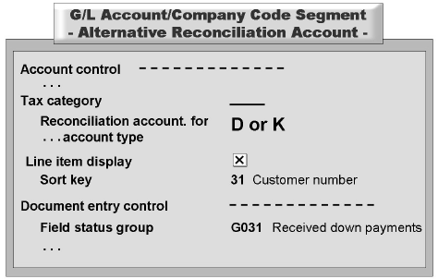
Configurations for Special G/L transactions
Special GL transactions are posted by means of
Posting keys
Special GL indicators
Special G/L transactions are posted to an account stored in Customizing and not to the reconciliation account stored in the master record.
For Special G/L accounts line item display must be activated.
Configuration for Special G/L accounts must be as follows:

Slide 42
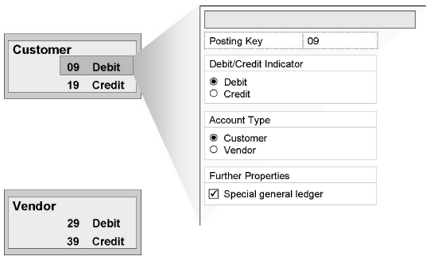
Posting key for Special G/L transactions
The special G/L transactions of the standard system are assigned to the posting keys {customer (09 and 19), Vendor (29 and 39)}.

Slide 43
Special G/L indicator
It is a pre configured single character indicator used to say the type of special G/L transaction.
It is defined separately for each account type.
Even though Spl G/L indicators are pre-configured, as per the requirement, we can change:
Different account numbers for reconciliation accounts or special G/L accounts
Other posting keys or G/L indicators for individual transactions
Other settings for the automatic postings, including the accounts to be posted to, posting keys and rules for account assignments with automatic postings.
Account type is important, as special G/L indicators are configured separately for each account type.
The special G/L indicator indicates that the posting key is used to enter special G/L transactions.
Click to view
SAP SCREEN

Slide 44
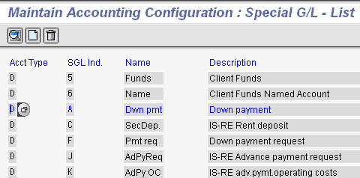
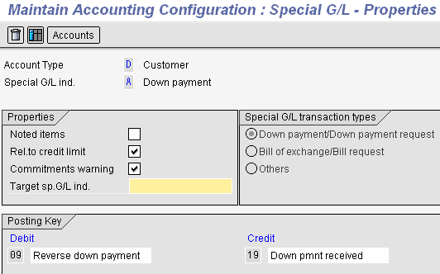
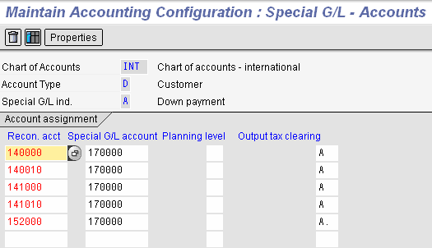

Slide 45
Spl. G/L indicators: Properties and Accounts
The characteristics of each special G/L indicator are defined in connection with the account type under Properties.
Noted items: You can determine that a special G/L transaction does not update any account balances.
Relevance to credit limit check: You can include special G/L transactions in the credit limit check for customers.
Warning against commitments: You can determine that the user is notified by a warning message about the existence of a special G/L transaction when posting to a customer or vendor account.
Target special G/L indicator: The target special G/L indicator is used in the standard system for down payment requests.
Special G/L transaction class: The special G/L transaction class determines whether the transaction is a down payment, a bill of exchange or any other type of transaction.
Posting key: Only these posting keys can be used with the respective special G/L indicators.
The alternative Special G/L account is stored in the account determination according to the chart of
accounts.
If a special G/L indicator is used when posting customer/vendor invoice, instead of posting to the
respective reconciliation account the Alternative reconciliation account assigned in account
determination gets posted.
Click to view
SAP SCREEN

Slide 46
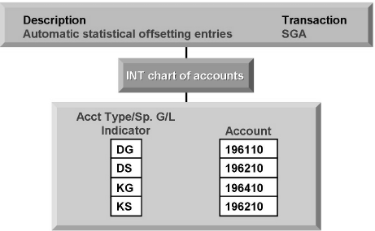
Automatic offsetting entries
Statistical postings are always made on the same offsetting account. The account is stored on the basis of a combination of the account type (customer or vendor account) and the special G/L indicator used.
Configuration for automatic offsetting entries

Slide 47
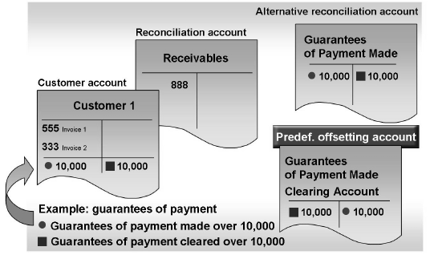
Example of Automatic offsetting entry
Two line items with postings on a predefined offsetting account

Slide 48
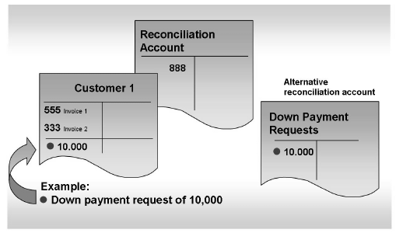
Example of Noted item
Noted item is created.
The transaction figures are not updated in the general ledger in the process.

Slide 49
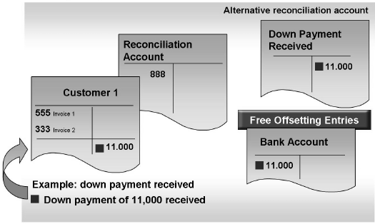
Example of free offsetting entry
The account for the offsetting item is entered at the same time as the posting.

Slide 50
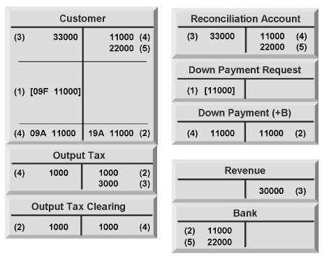
Example of down payment in customer area
The down payment request is posted.
The down payment made is entered.
The vendor invoice is created.
The down payment is cleared.
The payment is cleared during the payment of the balance.

Slide 51
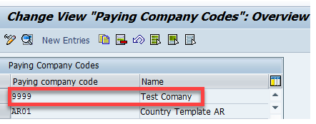
Paying the down payment with the payment program (F110)
IMG — Financial Accounting (New) —- Accounts Receivable and Accounts Payable—- Business Transactions— Outgoing Payments— Automatic Outgoing Payments—- Payment Method/Bank Selection for Payment Program— Set Up All Company Codes for Payment Transactions

Slide 52
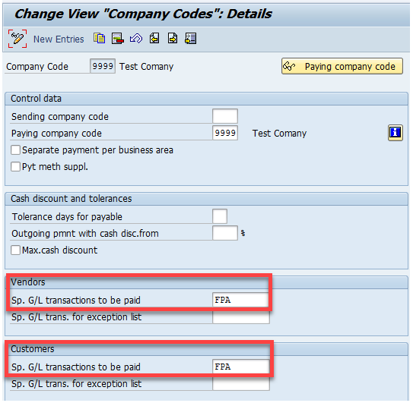
Paying the down payment with the payment program (F110)
Double click on your company code.

Slide 53
Bills of Exchange:
Bills of exchange are handled as special G/L transactions in the SAP System. These transactions are thus maintained independently of other transactions in the subsidiary ledger and are posted to a special G/L account in the general ledger.
The following types of bill of exchange can be managed in and posted to the Accounts
Receivable (FI-AR) and Accounts Payable (FI-AP) application components:
Bills of Exchange Receivable
Bank Bills and Bills of Exchange Payment Requests
Bills of Exchange Payable
Check/bill of exchange in Accounts Receivable (reverse bill of exchange)
Check/bill of exchange in Accounts Payable (reverse bill of exchange)

Slide 54
Bills of Exchange Receivable:
Bills of exchange receivable are managed using the special G/L method in the SAP System. When posting a bill of exchange receivable, you normally clear open items or post the payment as a payment on account. The system posts a bill of exchange receivable to the customer account and reduces the receivables from goods and services on the reconciliation account. The bill of exchange receivable is also automatically posted to the special G/L account for bills of exchange receivable in the general ledger.
Bills of exchange are a form of short-term finance. If your customer pays by bill of exchange, he does not make payment immediately, but only once the period specified on the bill has elapsed (three months, for example). Bills of exchange can be passed on to third parties for refinancing.

Slide 55
Help me
Tips and Tricks
List of sites where SAP functional & help documentation is available:
http://help.sap.com/saphelp_47x200/helpdata/en/e1/8e51341a06084de10000009b38f83b/frameset.htm/ provides detailed help on R/3 core modules.
Sap releases notes and updates on various functionalities which are available at https://websmp209.sap-ag.de/ (sap market place) site of SAP.
OSS login: Each SAP corporate client is provided with login for
Support and maintenance to https://websmp209.sap-ag.de/ sap service marketplace site by SAP. Any critical issues with respect to specific application can be discussed with SAP itself through OSS login.
Various other sites storing SAP information are http://erpgenie.com/ ; http://www.sapfans.com/

